Slide 1
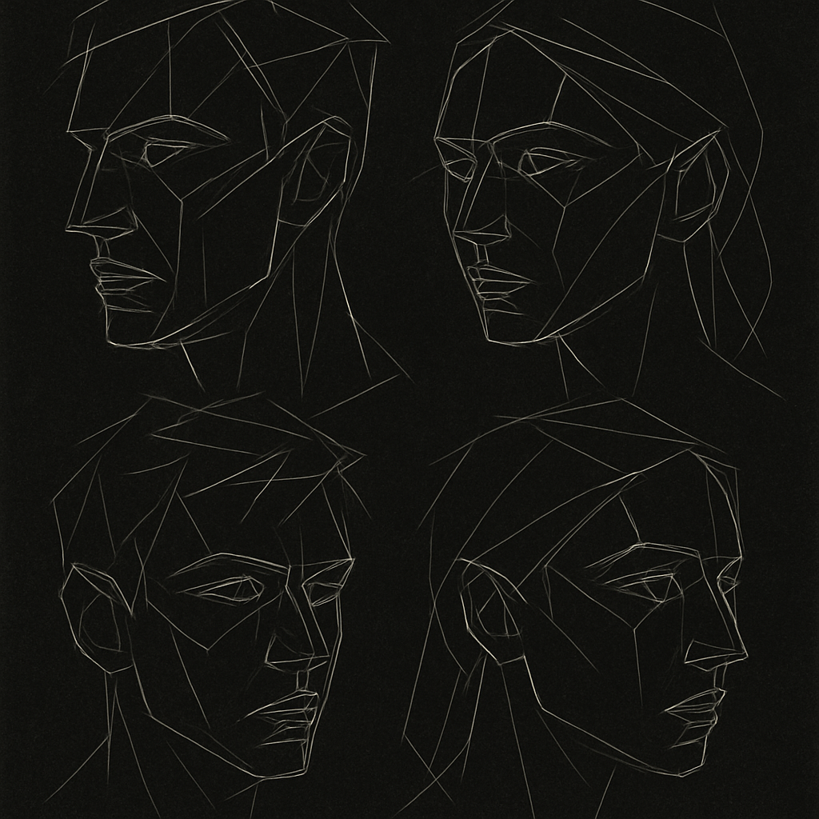

Friendly: Custom-built Convolutional Neural Network Optimized for Classifying Friendly Faces. Also, Comparative Analysis of other Finetuned Models - Resnet50 & CLIP
FriendNet: Recognizing Friendly Faces
CHRIS-MBA MIRACLE
5th August, 2025.

Slide 2
01
FriendNet
Custom convolutional neural network optimized for face recognition
02
Resnet50
Deep residual network with skip connections for robust feature extraction
03
CLIP
Multi-modal neural network trained on diverse image-text pairs
Introduction
Classify faces of five friends (Tatyana, Uzair, Jacob, Luke, Osama) using deep learning.
Application: Security, social media tagging, personalized systems.

Slide 3
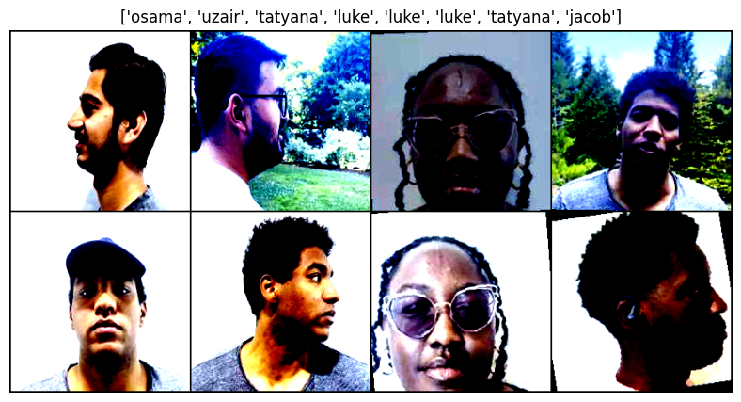
DATASET PREPARATION
2:30mins Videos Frames Extracted into JPEG Images
Preprocessing
Splits
Augmentation
Frames resized to (224, 224)
Normalized (e.g., mean: [0.485, 0.456, 0.406], std: [0.229, 0.224, 0.225].
Training: 700 images/class (3500 total).
Validation: 150 images/class (750 total)
Test: 150 images/class (750 total).
Used Color Jittering, resizing, and shifts.
Balanced Classes (eg., Luke 445 → 700 training Images)

Slide 4

Model Architectures
Friendnet(Custom CNN)
3 Conv2d layers (3→64, 64→128, 128→256), BatchNorm, ReLU, MaxPooling, Dropout (p=0.5)
Fully connected layers: 200704 → 512 → 5 classes.
ResNet50
Pre-trained on ImageNet, final layer modified (1000 → 5 classes).
Bottleneck blocks with Conv2d, BatchNorm, ReLU.
CLIP
Open AI’s CLIP with a linear classifier for 5 classes.
Multimodal pre-training for robust feature extraction.

Slide 5
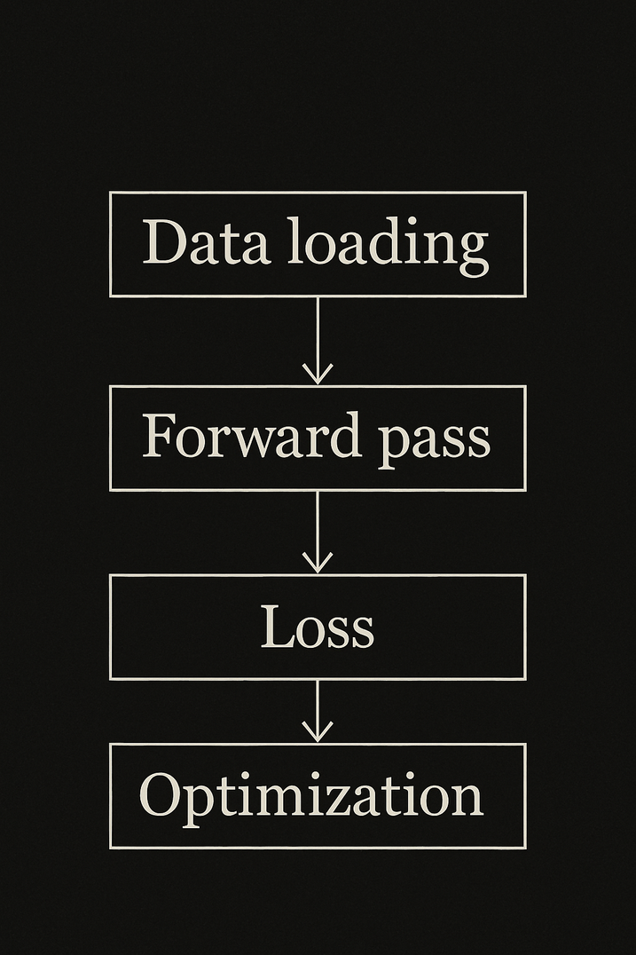
Training Process
Hyperparameters:
Optimizer: SGD (lr=0.0001, momentum=0.9).
Loss: CrossEntropyLoss.
Epochs: 30, with early stopping (patience: 10).
Device: CUDA (GPU) or CPU.
Process:
Training loop with batch size 30.
Validation after each epoch to track loss/accuracy.
Best model saved based on lowest validation loss.

Slide 6
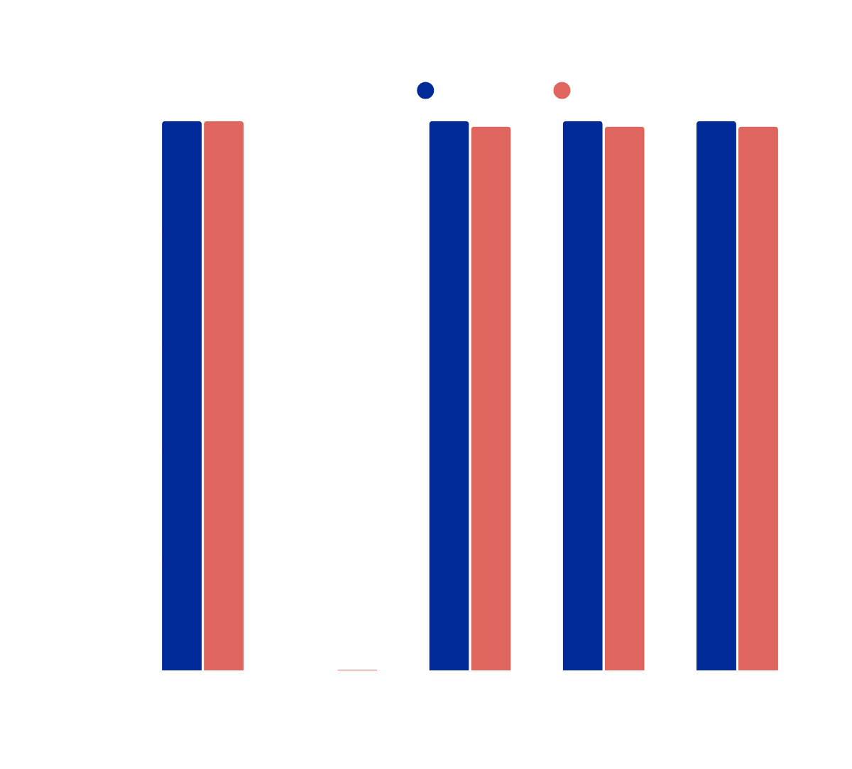
Model Performance
FriendNet had 96.67% validation and ~95.73% test accuracy.
ResNet50 achieved 100% accuracy and perfect precision, recall, and F1.
CLIP scored 100% validation and 99.87% test accuracy with near-perfect metrics.
Bar chart shows all, with ResNet50 and CLIP leading.

Slide 7
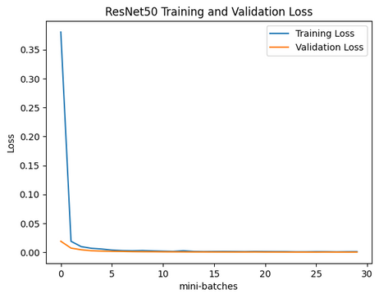
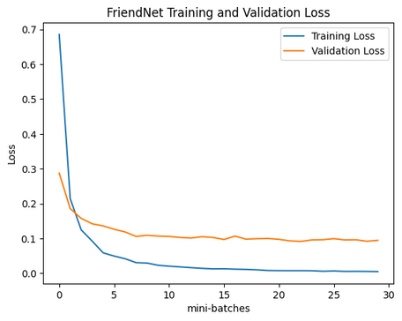
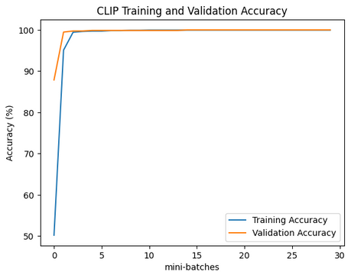
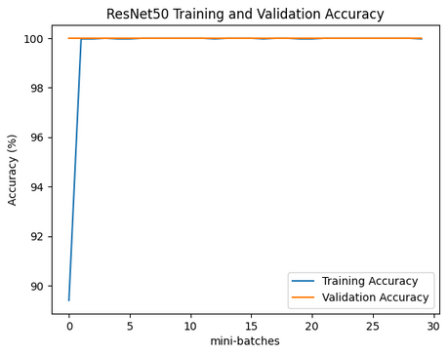
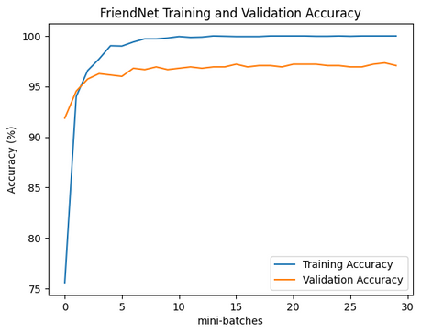
Loss and Accuracy Curves

Slide 8
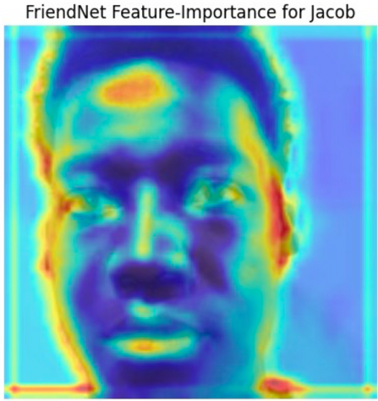
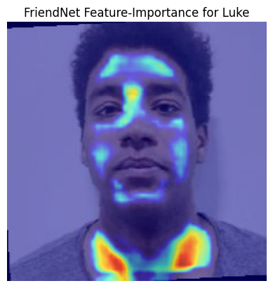
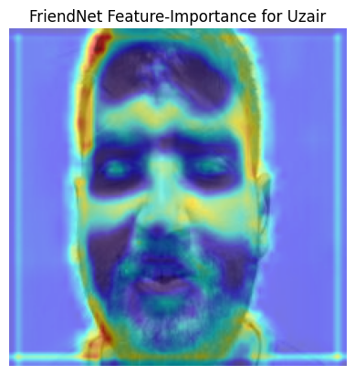
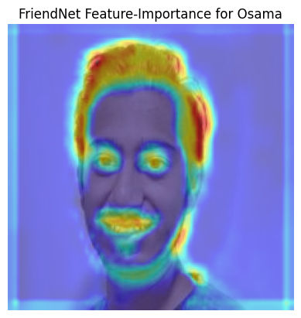
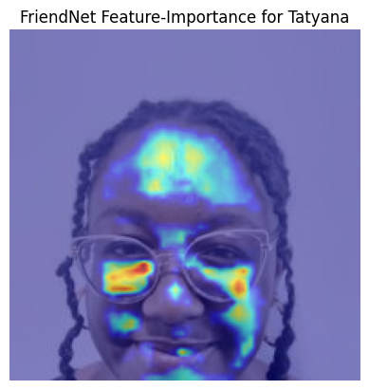
Grad-Cam | Explainability
Pre-trained models focus on discriminative facial features, enhancing accuracy.

Slide 9
Conclusion and Future Work
Summary:
ResNet50 and CLIP achieved near-perfect accuracy (100%, 99.87%).
FriendNet performed well (~95.73%) but lagged due to lack of pre-training
Balanced dataset and visualizations ensured robust analysis.
Future Work:
Explore advanced augmentation (e.g., CutMix).
Increase dataset size/diversity.
Test ensemble methods combining all models.
Test ensemble methods combining all models.

Slide 10
LIVE DEMO
We’ll test the robustness of our Models
ON
Evaluation Sets
Unseen Sets
Group Photo
QUESTIONS
Connect
Gracias
Queries are welcomed at this time
chrismba.com
Thank you for your time :)

